Slide 1
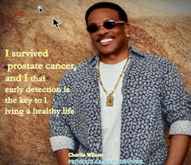
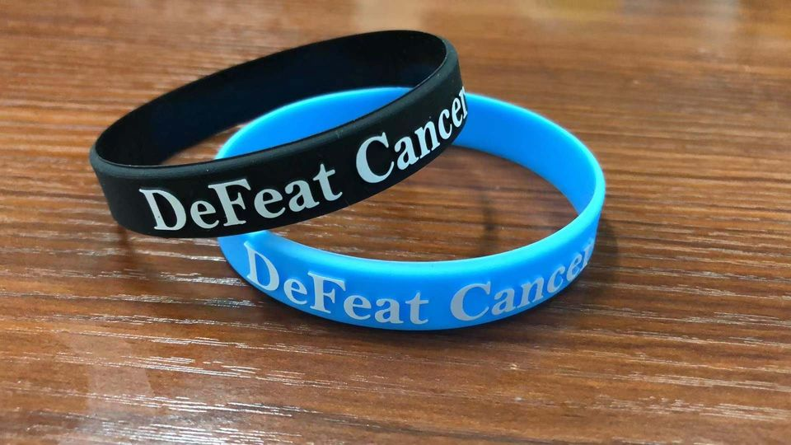
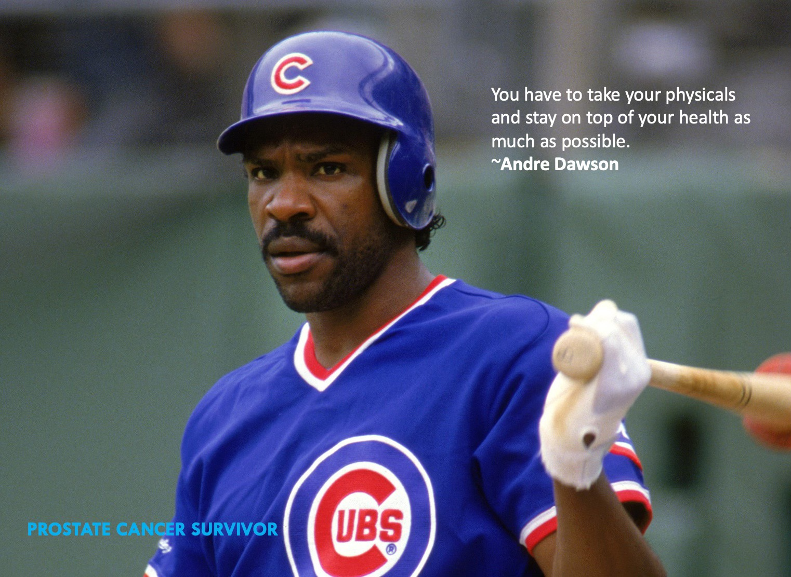
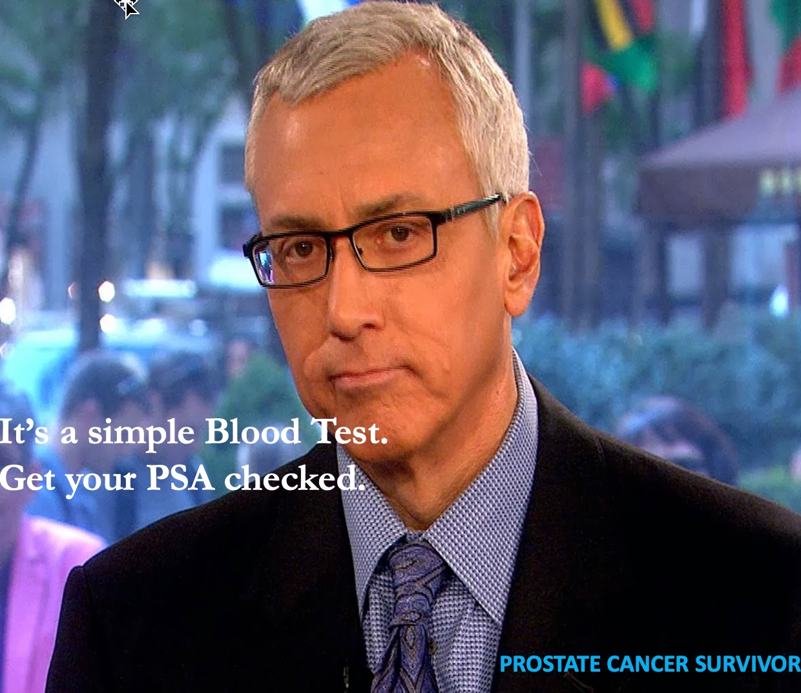
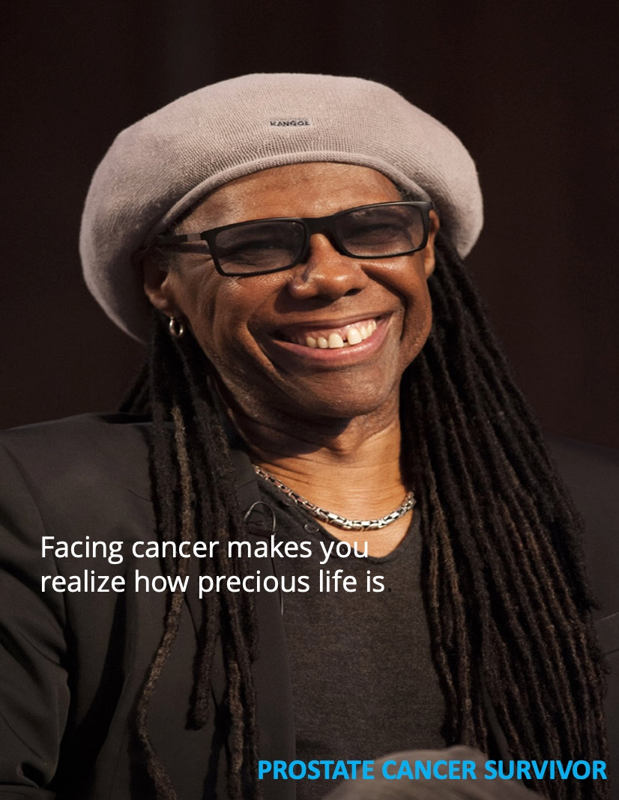
What do they have in common?
Screened for prostate cancer using a PSA test?
Prostate Cancer Survivors
Defeatcancers.com
We are a 501(c) 3 organization

Slide 2
We are a 501(c) 3 organization
Defeat Cancer
Prostate Cancer is not a death sentence; facing it with a positive mindset goes a long way toward a successful treatment and cure.
Defeatcancers.com

Slide 5
Defeatcancers.com
We are a 501(c) 3 organization
We are a 501(c) 3 organization
Defeatcancers.com

Slide 6
Defeatcancers.com

Slide 7
Prostate Cancer Awareness Group
to
DeFeat Cancer!
.
Defeatcancers.com

Slide 8
Remember, you don't have to go it alone; we're here to help!
Defeatcancers.com

